Slide 1
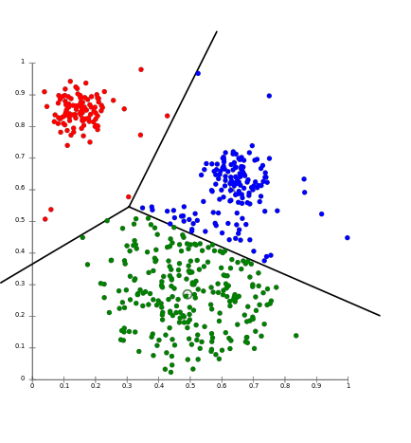
K-means clustering – Project proposal
Marzia Matejcek, Leonie Gerling,
Annika Wehrle, Ege Bayraktar

Slide 2
A few questions
Which algorithm for which type/ size of data?
Limits of several algorithms?
What could we predict if the clustered the data?

Slide 3
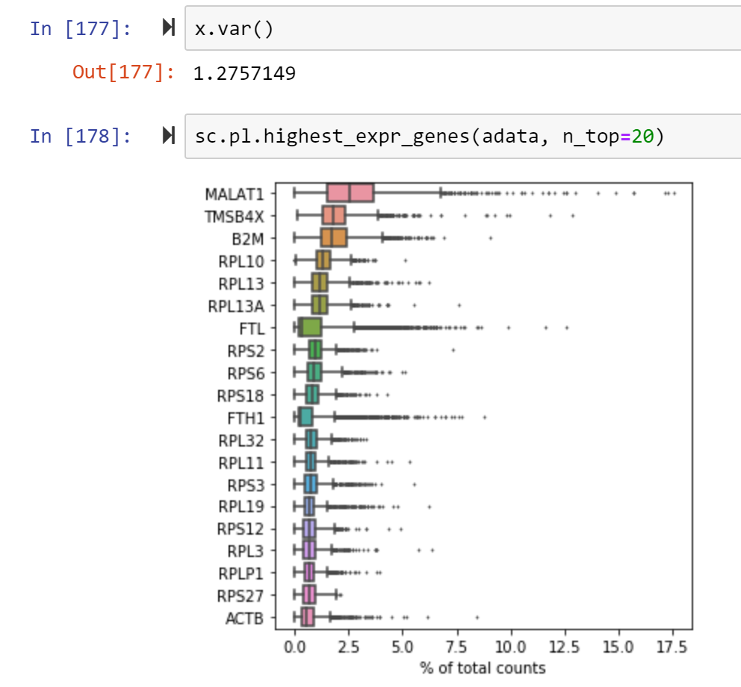
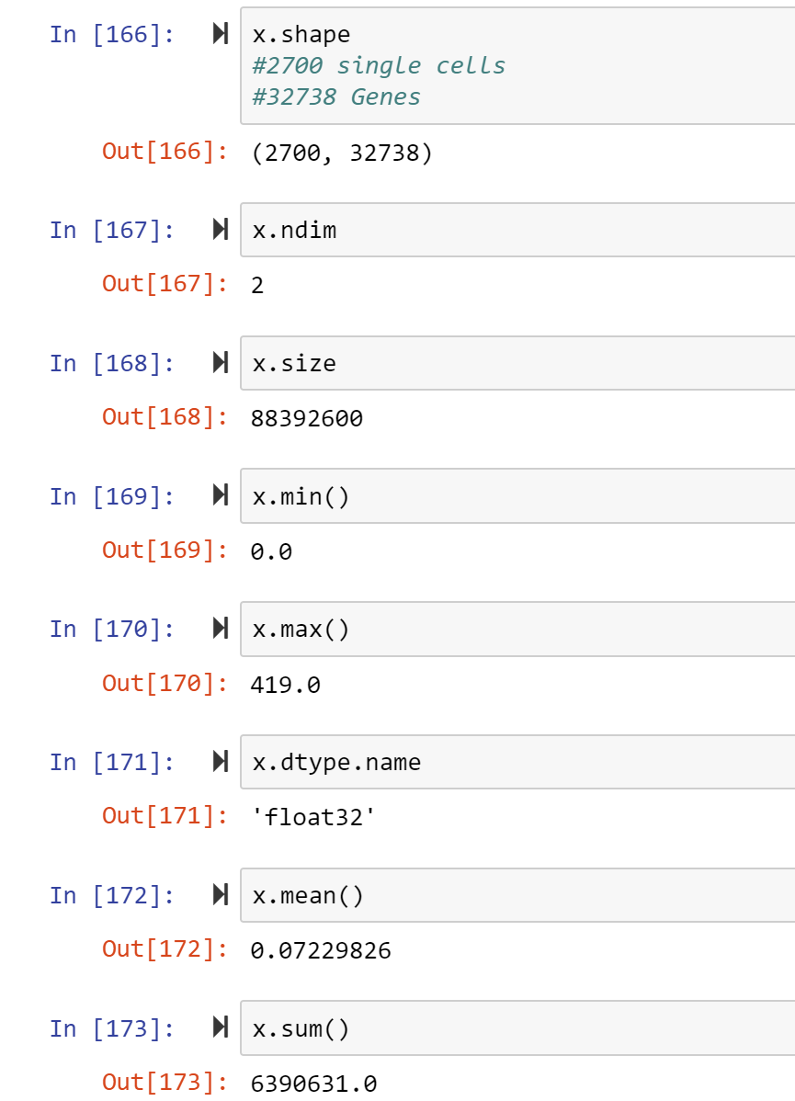
Data exploration

Slide 4
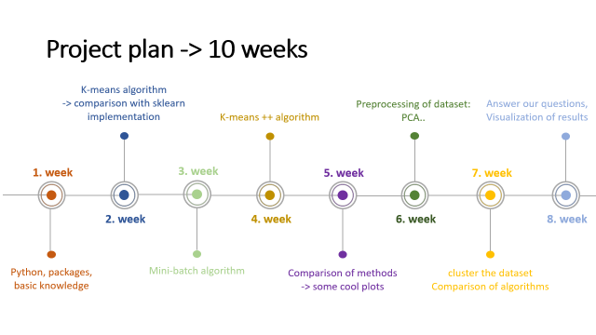
Project plan -> 10 weeks
K-means algorithm
-> comparison with sklearn implementation
1. week
2. week
Python, packages, basic knowledge

Slide 5
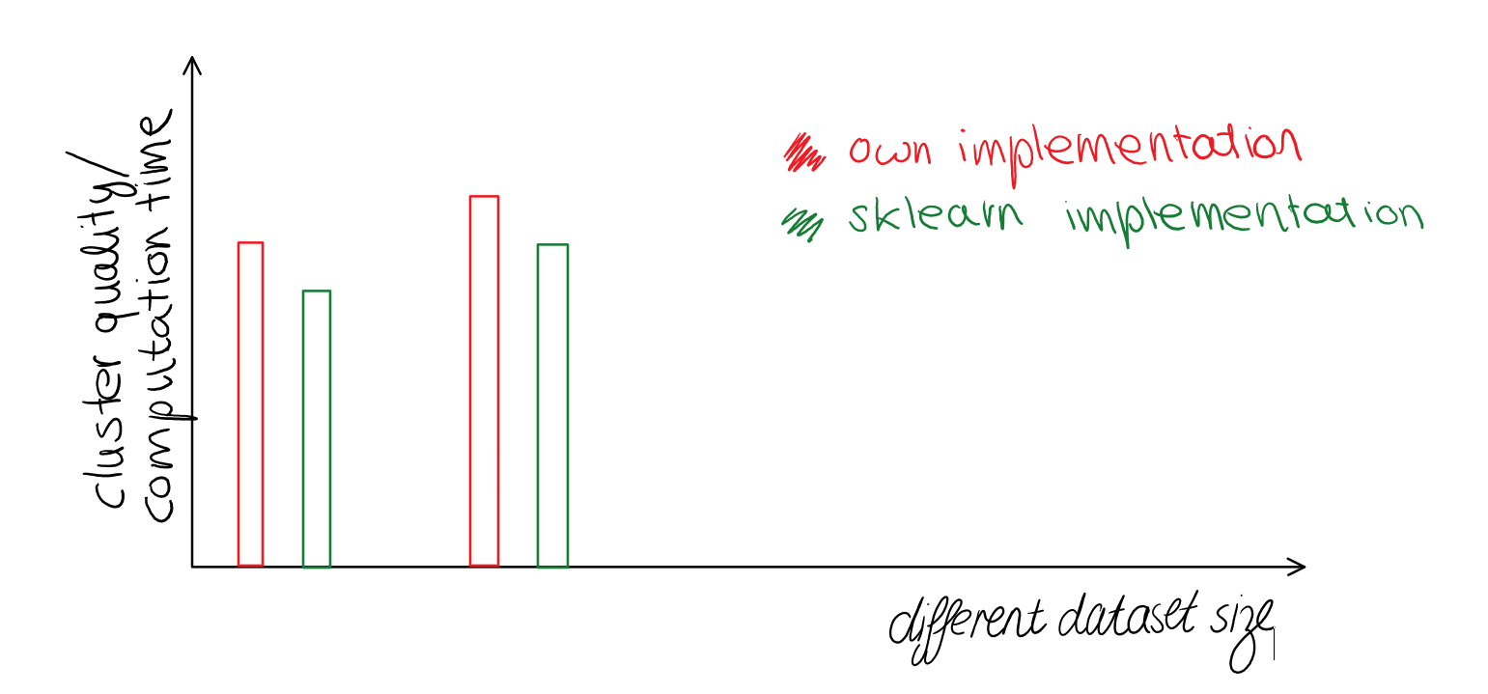
Tabels for different datasets with various sizes:
Multiple plots for visualization:
e.g. :
k | Average sum of squared distance Algorithm sklearn implementation |  | Minimum - “ - |  | Average T (computation time)
i.e. 10
25
50

Slide 6
Project plan -> 10 weeks
K-means algorithm
-> comparison with sklearn implementation
Preprocessing of dataset: PCA..
Answer our questions,
Visualization of results
K-means ++ algorithm
1. week
3. week
5. week
7. week
2. week
4. week
6. week
8. week
Python, packages, basic knowledge
Mini-batch algorithm
Comparison of methods -> some cool plots
cluster the dataset
Comparison of algorithms

